Slide 1
KHATRA ADIBASI MAHAVIDYALAYA
B.A Program in Physical Education Name of the Teacher- TITHI ROY
Subject- Physical Education
Semester - III
Course Title: Yogasana and Gymnastics
Topic: Unit- I: YOGASANA
Session: 2019-20

Slide 2
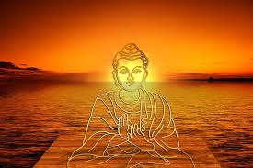
YOGA

Slide 3
BHUJANGASANA

Slide 4
Steps of Bhujangasana

Slide 5
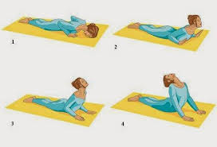
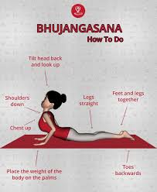
Steps of Bhujangasana

Slide 6
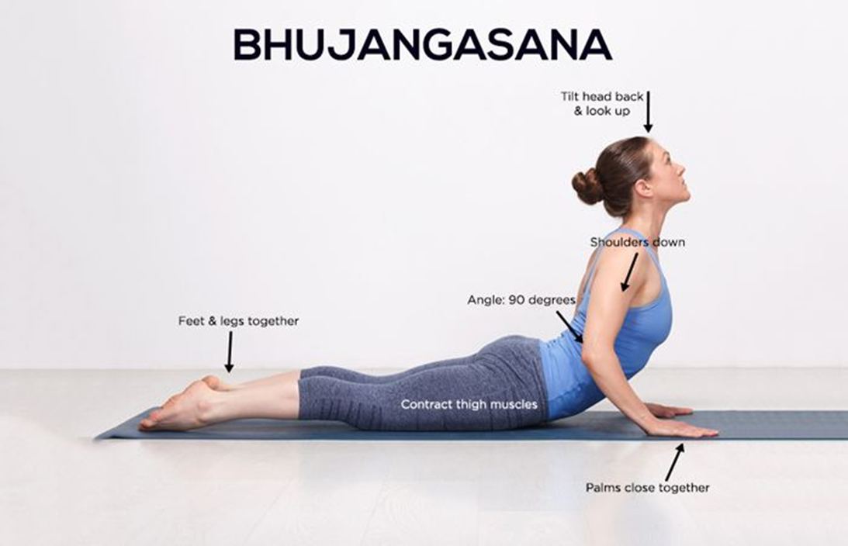

Slide 7
Benefits of Bhujangasana
Strengthens the spine.
Stretches chest and lungs, shoulders, and abdomen.
Tones the buttocks.
Stimulates abdominal organs.
Helps relieve stress and fatigue.
Opens the heart and lungs.
Soothes sciatica.
Therapeutic for asthma.

Slide 8
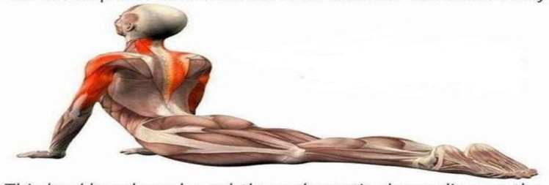
Benefits of Bhujangasana

Slide 9
Benefits of Bhujangasana

Slide 10
THANK YOU

